Slide 1
Kubernetes Workshop: Develop and Deploy a Microservices Application on Kubernetes
Dell Technologies Educations Services

Slide 2
Workshop Agenda
DAY 1
Why Cloud Native ?
Introduction to Cloud Native Development
Introduction to containerization
Getting Started with Kubernetes and Vmware Enterprise PKS
Understanding Declarative Configuration for Kubernetes
Deploying your First Java Spring Boot Application to the Kubernetes Cluster
Externalizing configuration in Kubernetes

Slide 3
Workshop Agenda
DAY 2
Logging and Monitoring
Deploying containerized workloads on Kubernetes with pipeline
Persisting data in Kubernetes using PV & PVC

Slide 4
Workshop Agenda
DAY 3
Building a microservice application
Implementing service discovery on Kubernetes for microservice application
Expose your service with Loadbalancer
Continuously deploy microservice application with pipeline

Slide 5
Why Cloud Native?

Slide 6
Business Challenges
“Our Opex cost for maintaining Legacy applications is 35% of Total Revenue”
Our Go-To-Market timeline is around 4 to 6 months
“There is a 61% increase in mobile clientele footprint and applications are not able to handle that”
We have invested in cloud, however we have over 500 legacy applications which is hitting 17% of bottom-line due to higher TCO”
“We have seen 11% customer attrition due to lack of Multi Channel User Experience”
We see most customers grappling to modernize their existing applications and need help in migrating their apps to cloud.

Slide 7
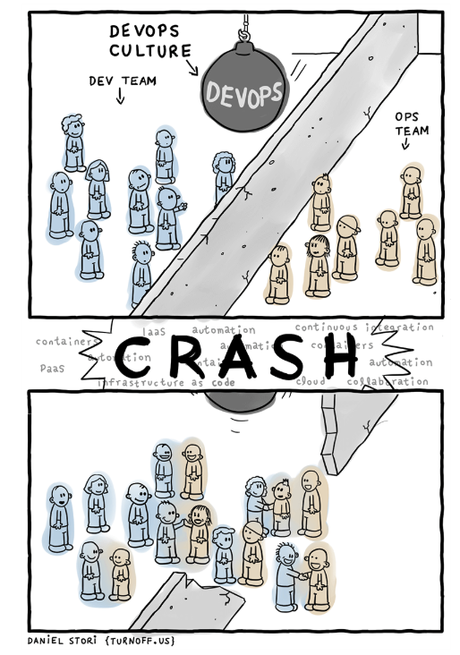
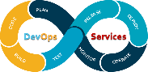
Organizational Challenges
Not my problem
Separate tools, varied incentives, opaque process
Shared responsibility
Common incentives, tools, process and culture
Regularly ships quality software
Moving ahead with lean and agile development
Collaborates between multiple teams
Avoids friction and delay

Slide 8
Developers Challenges
Developer Issues:
• Minor code changes require full re-compile and re-test
• Application becomes single point of failure
• Application is difficult to scale
Microservices:
Break application into separate operations
Make the app independently scalable, stateless, highly available by design

Slide 9







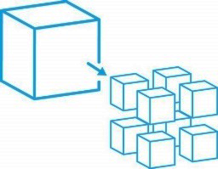


Application Transformation
Legacy Application
Modernized Application
Interface Channel
Single Interface
Multiple Interfaces/
Omni Channel
Process
Waterfall
Agile
Manual
DevOps, Automated
Architecture
Monolithic
Microservices
Infrastructure
Datacenter Hosted
Hybrid Multi Cloud
Hosted

Slide 10
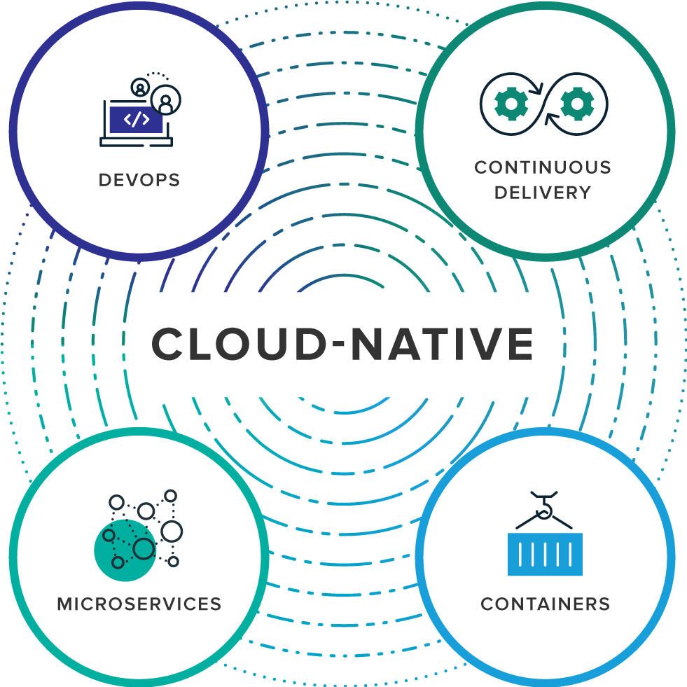
Cloud Native
“Cloud-native is an approach to building and running applications that exploits the advantages of the cloud computing delivery model. Cloud-native is about how applications are created and deployed, not where. ”
pivotal.io/cloud-native

Slide 11




Spring Boot
Takes an opinionated view of building production-ready Spring applications
Convention over Configuration
Provides dependency management
Auto-configurations
Starter dependencies
Actuators
Tomcat
pom.xml
Spring Boot
Auto Configuration

Slide 12
Lab 1: Hello World Spring Boot App

Slide 13
Introduction to Containerization

Slide 14
History
In the Dark Ages
One application on one physical server
Historical limitations of application deployment
Slow deployment times
Huge costs
Wasted resources
Difficult to scale
Difficult to migrate
Vendor lock in

Slide 15
Evolution
Hypervisor-based Virtualization
• One physical server can contain multiple applications
• Each application runs in a virtual machine (VM)
Benefits
• Better resource pooling
– One physical machine divided into multiple virtual machines
• Easier to scale
Limitations of VM
• Each VM stills requires
– CPU allocation
– Storage
– RAM
– An entire guest operating system
• The more VMs you run, the more resources you need
• Guest OS means wasted resources
• Application portability not guaranteed

Slide 16
Containerization v Virtualization
Containers isolate and abstract resources
Apps run in a container
Containers allow multiple apps to run in a single VM
Apps
Apps
Maximizes utilization without OS overhead
Apps
Apps
bins/libs
bins/libs
Apps
Apps
GuestOS
GuestOS
bins/libs
bins/libs
Hypervisor
bins/libs
bins/libs
Container Engine (Docker)
HostOS
HostOS
HostOS
Hardware
Hardware
Hardware
Virtualization
Containerization
Custom containers

Slide 17
Containerization v Virtualization

Slide 18
What is Docker?
A company as well a Product
Standardized packaging for software and dependencies
Isolate apps from each other
Share the same OS kernel
Works with all major Linux and Windows Server
Notes:
A tool that can package an application and its dependencies in a virtual container.
Implementation of a container which is portable using a concept of image
Docker uses host OS kernel, there is no custom or additional kernel inside container. All containers runs on machine are sharing this "host" kernel.
Docker uses resource isolation features of the Linux kernel such as cgroupsand kernel namespaces to allow independent "containers" to run within a single Linux instance, avoiding the overhead of starting virtual machines.

Slide 19
Docker Key Concepts
The basis of a Docker container. Represents a full application
Docker Container
The standard unit in which the application service resides and executes
Docker Engine
Creates, ships and runs Docker containers deployable on a physical or virtual, host locally, in a datacenter or cloud service provider
Registry Service (Docker Hub or Docker Trusted Registry)
Cloud or server based storage and distribution service for your images
Notes:
A tool that can package an application and its dependencies in a virtual container.
Implementation of a container which is portable using a concept of image
Docker uses host OS kernel, there is no custom or additional kernel inside container. All containers runs on machine are sharing this "host" kernel.
Docker uses resource isolation features of the Linux kernel such as cgroupsand kernel namespaces to allow independent "containers" to run within a single Linux instance, avoiding the overhead of starting virtual machines.

Slide 20
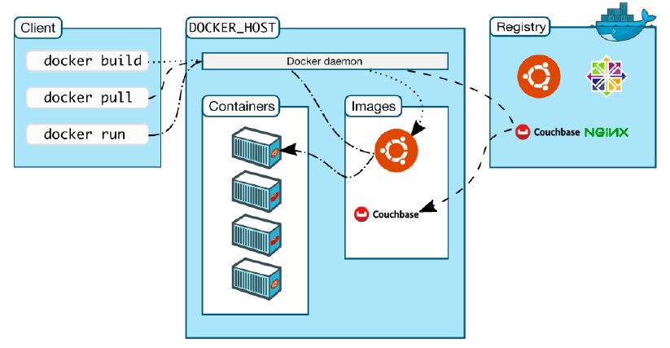
Docker Architecture
Notes:
A tool that can package an application and its dependencies in a virtual container.
Implementation of a container which is portable using a concept of image
Docker uses host OS kernel, there is no custom or additional kernel inside container. All containers runs on machine are sharing this "host" kernel.
Docker uses resource isolation features of the Linux kernel such as cgroupsand kernel namespaces to allow independent "containers" to run within a single Linux instance, avoiding the overhead of starting virtual machines.

Slide 21
Dockers Image Layering
Notes:
A tool that can package an application and its dependencies in a virtual container.
Implementation of a container which is portable using a concept of image
Docker uses host OS kernel, there is no custom or additional kernel inside container. All containers runs on machine are sharing this "host" kernel.
Docker uses resource isolation features of the Linux kernel such as cgroupsand kernel namespaces to allow independent "containers" to run within a single Linux instance, avoiding the overhead of starting virtual machines.

Slide 22
Basic Docker Commands
Pulling Docker Image
$ docker pull yourrepo/yourapp
Listing out Docker Images
$ docker image ls
Running Docker Containers
$ docker run –d –p 5000:5000 –-name yourapp yourrepo/yourapp
Stopping the container
$ docker container stop yourapp(or <container id>)
Notes:
A tool that can package an application and its dependencies in a virtual container.
Implementation of a container which is portable using a concept of image
Docker uses host OS kernel, there is no custom or additional kernel inside container. All containers runs on machine are sharing this "host" kernel.
Docker uses resource isolation features of the Linux kernel such as cgroupsand kernel namespaces to allow independent "containers" to run within a single Linux instance, avoiding the overhead of starting virtual machines.

Slide 23
Understanding Docker File
# Use an OpenJDK Runtime as a parent image
FROM openjdk:8-jre-alpine
# Add Maintainer Info
LABEL maintainer=pal_k8@dell.com
# Define environment variables
ENV SPRING_OUTPUT_ANSI_ENABLED=ALWAYS \
JAVA_OPTS=""
# Set the working directory to /app
WORKDIR /app
# Copy the executable into the container at /app
ADD *.jar app.jar
# Make port 8080 available to the world outside this container
EXPOSE 8080
# Run app.jar when the container launches
CMD ["java", "-Djava.security.egd=file:/dev/./urandom", "-jar", "/app/app.jar"]
Notes:
A tool that can package an application and its dependencies in a virtual container.
Implementation of a container which is portable using a concept of image
Docker uses host OS kernel, there is no custom or additional kernel inside container. All containers runs on machine are sharing this "host" kernel.
Docker uses resource isolation features of the Linux kernel such as cgroupsand kernel namespaces to allow independent "containers" to run within a single Linux instance, avoiding the overhead of starting virtual machines.

Slide 24
Lab 2: Dockerize your Spring Boot App
● Building a Spring boot application
● Dockerize spring boot app
● Push docker image to docker hub
● Run docker container and test locally

Slide 25
Need of Orchestration

Slide 26
Introduction to Kubernetes

Slide 27
What is Kubernetes?
Kubernetes is an open source orchestration system for managing containerized applications across multiple hosts, providing basic mechanisms for the deployment, maintenance, and scaling of applications.
Originally sprung out of decades of container experience from inside Google (Borg, Omega, LMCTFY, etc.)
Independent OSS project within the CNCF
Production ready since July 2015.
It Provides declarative primitives for the “desired state”
Self-healing
Auto-restarting
Schedule across hosts
Replicating

Slide 28
What does Kubernetes do?
● Acts as the “Linux kernel of distributed systems”
● Abstracts away the underlying hardware
● You declare a state, and Kubernetes’ main purpose is to make that happen
● Handles placement and scheduling of containers on nodes
● Provides basic monitoring, logging, and health checking
● Enables containers to discover each other.

Slide 29
Architecture Overview

Slide 30
Kubernetes Architecture
Cloud Provider Network Edge
Worker Node 1
Kubernetes control plane
Pod
Pod
kube-controller Manager
CRI
CRI
kube-controller Manager
Cloud-controller Manager
kubeproxy
kubelet
Load Balancer
kube-api
Server
Worker Node 2
Pod
Pod
Pod
Pod
etcd
CRI
CRI
Scheduler
kubeproxy
kubelet

Slide 31
Control Plane Components
Kubernetes control plane- The Master Node
kube-apiserver
etcd
kube-controller-manager
kube-scheduler
cloud-controller-manager
kube-controller Manager
Cloud-controller Manager
kube-api
Server
etcd
Scheduler

Slide 32
kube-apiserver
● Provides a forward facing REST interface into the kubernetes control plane and datastore.
● All clients and other applications interact with kubernetes strictly through the API Server.
● Acts as the gatekeeper to the cluster by handling authentication and authorization, request validation, mutation, and admission control in addition to being the front-end to the backing datastore.

Slide 33

etcd
● etcd acts as the cluster datastore.
● Purpose in relation to Kubernetes is to provide a strong, consistent and highly available key-value store for persisting cluster state.
● Stores objects and config information.

Slide 34
kube-controller-manager
● Monitors the cluster state via the apiserver and steers the cluster towards the desired state.
● Node Controller: Responsible for noticing and responding when nodes go down.
● Replication Controller: Responsible for maintaining the correct number of pods for every replication controller object in the system.
● Endpoints Controller: Populates the Endpoints object (that is, joins Services & Pods).
● Service Account & Token Controllers: Create default accounts and API access tokens for new namespaces.

Slide 35
kube-scheduler
● Component on the master that watches newly created pods that have no node assigned, and selects a node for them to run on.
● Factors taken into account for scheduling decisions include individual and collective resource requirements, hardware/software/policy constraints, affinity and anti-affinity specifications, data locality, inter-workload interference and deadlines.

Slide 36
cloud-controller-manager
● Node Controller: For checking the cloud provider to determine if a node has been deleted in the cloud after it stops responding
● Route Controller: For setting up routes in the underlying cloud infrastructure
● Service Controller: For creating, updating and deleting cloud provider load balancers
● Volume Controller: For creating, attaching, and mounting volumes, and interacting with the cloud provider to orchestrate volumes

Slide 37
Worker Node Components
kubelet
kube-proxy
Container Runtime Engine
Worker Node
Pod
Pod
CRI
CRI
kubeproxy
kubelet

Slide 38
kubelet
● An agent that runs on each node in the cluster. It makes sure that containers are running in a pod.
● The kubelet takes a set of PodSpecs that are provided through various mechanisms and ensures that the containers described in those PodSpecs are running and healthy.

Slide 39
kube-proxy
● Manages the network rules on each node.
● Performs connection forwarding or load balancing for Kubernetes cluster services.

Slide 40
Container Runtime Engine
● A container runtime is a CRI (Container Runtime Interface) compatible application that executes and manages containers.
Containered (docker)
Cri-o
Rkt

Slide 41
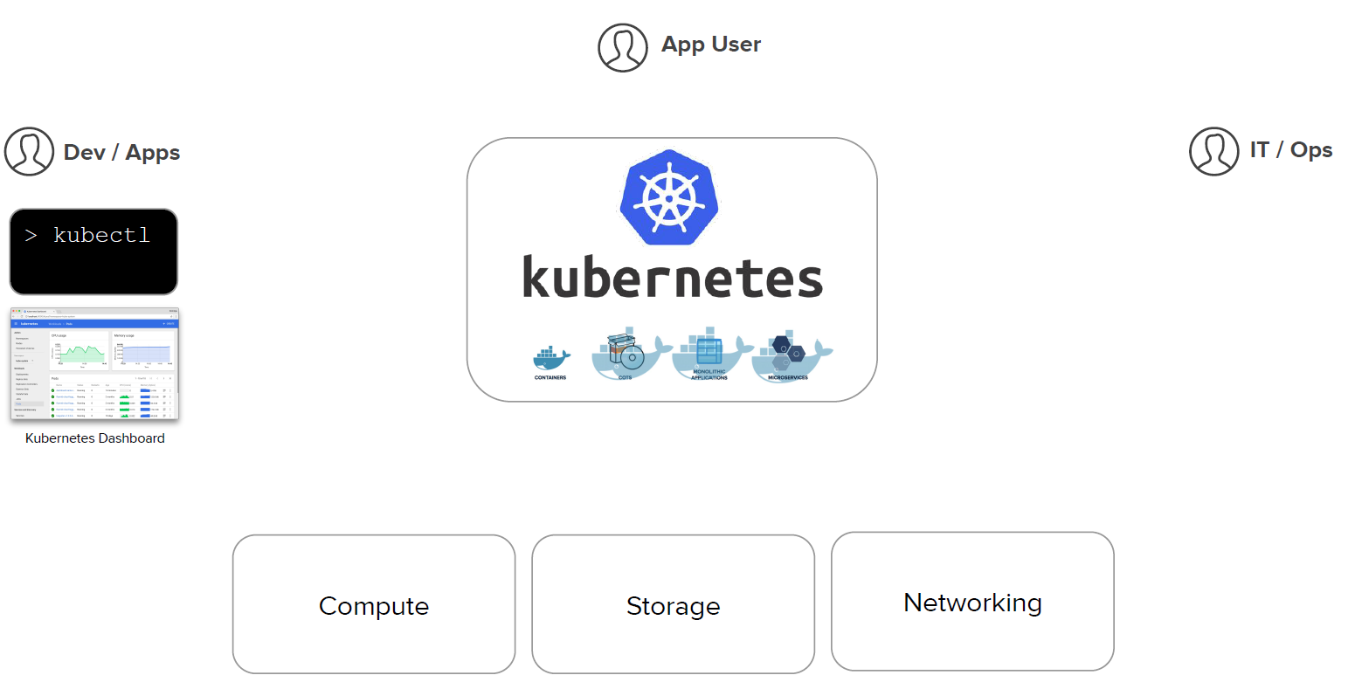
Kubernetes is a Runtime for Containerized Workloads

Slide 42
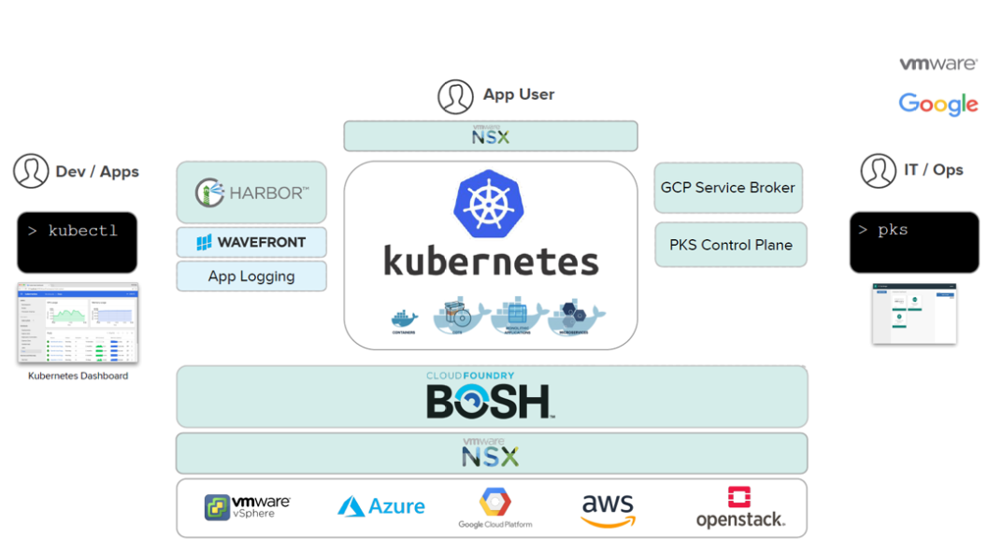
VMware Tanzu Kubernetes (formerly Ent PKS)
Notes:
VMware Tanzu Kubernetes Grid Integrated Edition (formerly Ent PKS)
https://network.pivotal.io/products/pivotal-container-service

Slide 43
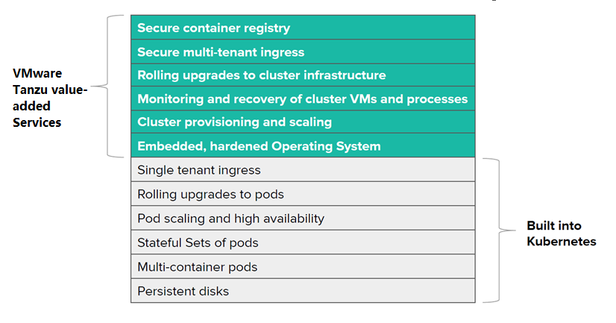
What VMware Tanzu adds to Kubernetes

Slide 44
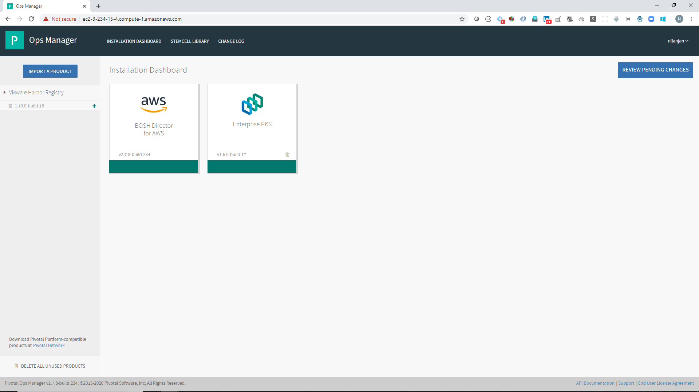
Vmware Enterprise PKS Running on AWS – An Ops manager view

Slide 45
Kubernetes Core Concepts

Slide 46
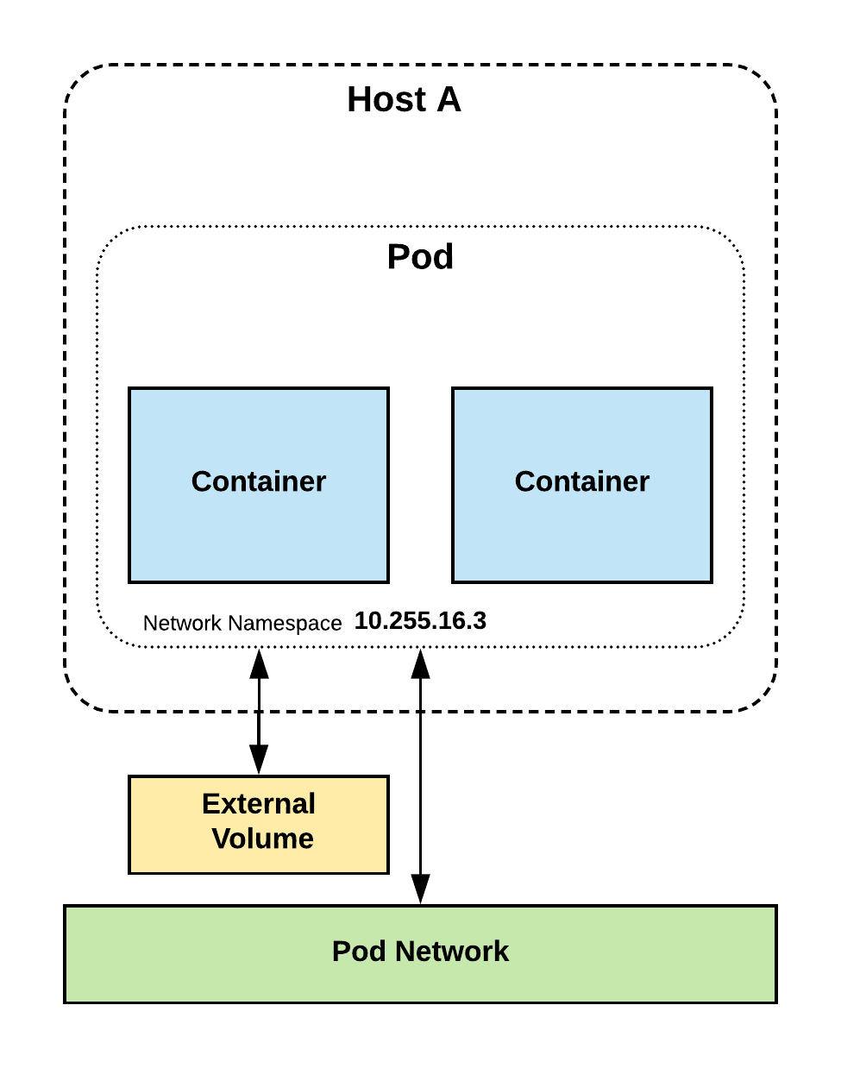
Pods
● A pod is the atomic unit of Kubernetes.
● Foundational building block of Kubernetes Workloads.
● Pods are one or more containers that share volumes, a network namespace, and are a part of a single context.
● They are also ephemeral ! higher level objects manage replicas, fault-tolerance etc

Slide 47
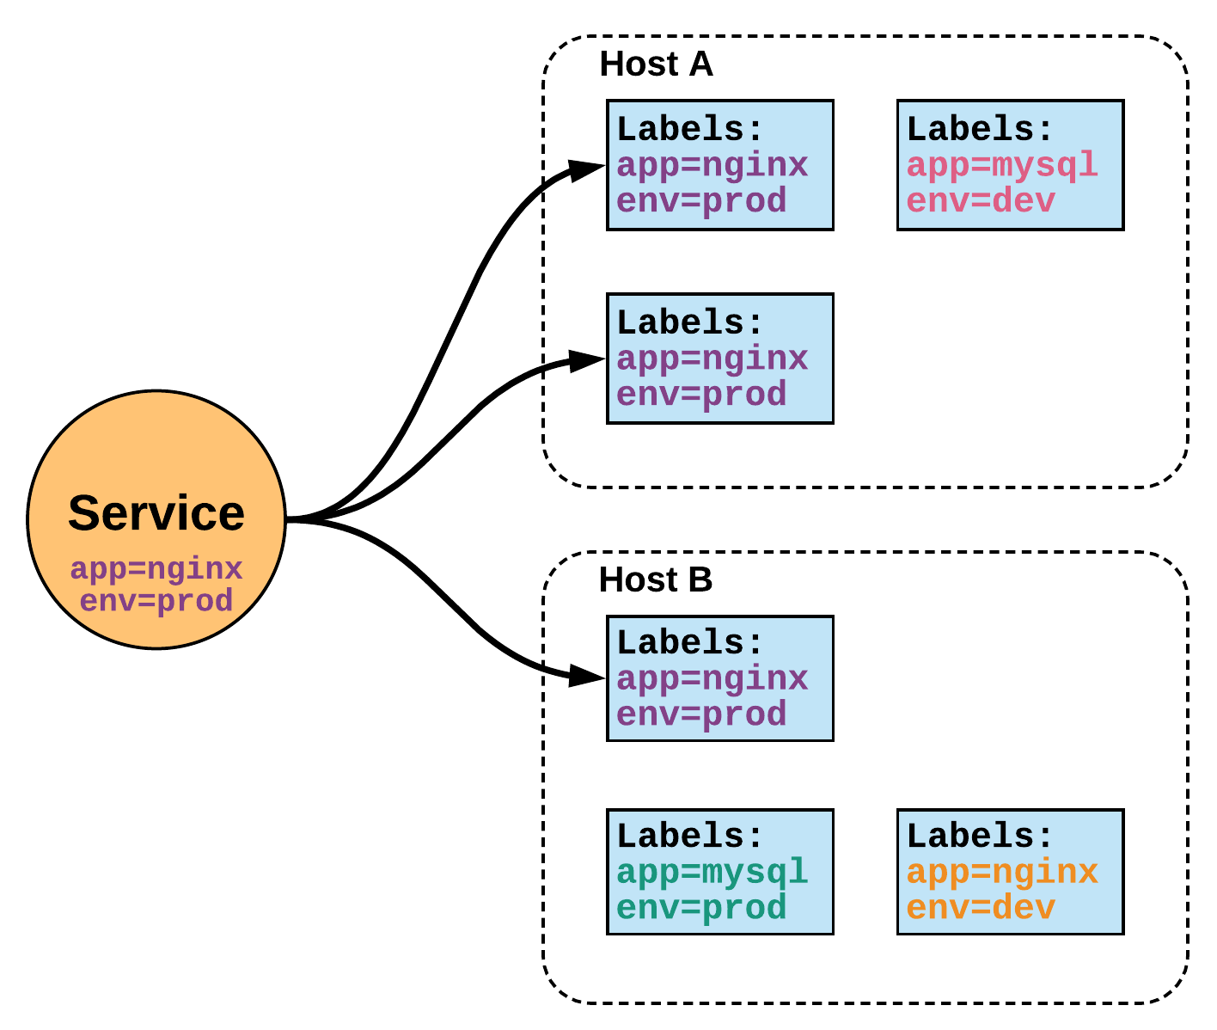
Services
● Services within Kubernetes are the unified method of accessing the exposed workloads of Pods.
● They are a durable resource (unlike Pods)
● Given a static cluster-unique IP, and in conjunction with kube-dns a static DNS name following the format of:
<service name>.<namespace>.svc.cluster.local

Slide 48
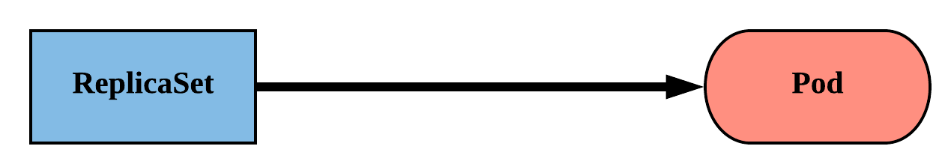
ReplicaSet
● Primary method of managing pod replicas and their lifecycle.
● Includes their scheduling, scaling, and deletion.
● Their job is simple: Always ensure the desired number of pods
are running.

Slide 49
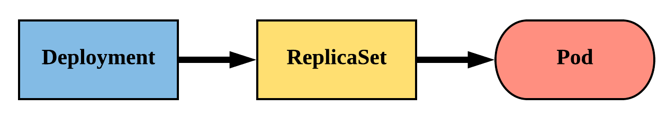
Deployment
● Way of managing Pods via ReplicaSets.
● Provide rollback functionality and update control.
● Updates are managed through the pod-template-hash label.
● Each iteration creates a unique label that is assigned to both the ReplicaSet and subsequent

Slide 50
Kubernetes Networking
● Pod Network - Cluster-wide network used for pod-to-pod communication managed by a CNI (Container Network Interface) plugin.
● Service Network - Cluster-wide range of Virtual IPs managed by kube-proxy for service discovery.

Slide 51
Kubernetes Networking Rules
● All containers within a pod can communicate with each other unimpeded.
● All Pods can communicate with all other Pods without NAT.
● All nodes can communicate with all Pods (and vice-versa) without NAT.
● The IP that a Pod sees itself as is the same IP that others see it as..

Slide 52
Understating Kubernetes API and Object Model -The Declarative Style

Slide 53
API Overview
The REST API is the true
keystone of Kubernetes.
Everything within the
Kubernetes platform is
treated as an API Object
and has a corresponding
entry in the API itself.

Slide 54
Object Model
● Objects within Kubernetes are a “record of intent” Persistent entity that represent
the desired state of the object within the cluster.
● At a minimum all objects MUST have an apiVersion, kind, and poses the nested
fields metadata.name, metadata.namespace, and metadata.uid.

Slide 55
Object Model Requirements
● apiVersion: Kubernetes API version of the Object
● kind: Type of Kubernetes Object
● metadata.name: Unique name of the Object
● metadata.namespace: Scoped environment name that the object belongs to (will
default to current).
● metadata.uid: The (generated) uid for an object.

Slide 56
Namespaces
Namespaces are a logical cluster or environment, and are the primary method of partitioning a cluster or scoping access.
apiVersion: v1
kind: Namespace
metadata:
name: prod
labels:
app: MyBigWebApp
$ kubectl get ns --show-labels
NAME STATUS AGE LABELS
default Active 11h <none>
kube-public Active 11h <none>
kube-system Active 11h <none>
prod Active 6s app=MyBigWebApp

Slide 57
Pod Container Attributes
name - The name of the container
image - The container image
ports - array of ports to expose. Can be granted a friendly name and protocol may be specified
env - array of environment variables
command - Entrypoint array (equiv to Docker ENTRYPOINT)
args - Arguments to pass to the command (equiv to Docker CMD)
Container
name: nginx
image: nginx:stable-alpine
ports:
- containerPort: 80
name: http
protocol: TCP
env:
- name: MYVAR
value: isAwesome
command: [“/bin/sh”, “-c”]
args: [“echo ${MYVAR}”]

Slide 58
ReplicaSet
replicas: The desired number of instances of the Pod.
selector: The label selector for the ReplicaSet will manage ALL Pod instances that it targets; whether it’s desired or not.
apiVersion: apps/v1
kind: ReplicaSet
metadata:
name: rs-example
spec:
replicas: 3
selector:
matchLabels:
app: nginx env: prod
template:
<pod template>

Slide 59
ReplicaSet
apiVersion: apps/v1
kind: ReplicaSet
metadata:
name: rs-example
spec:
replicas: 3
selector:
matchLabels:
app: nginx env: prod
template:
metadata:
labels:
app: nginx
env: prod
spec:
containers:
- name: nginx
image: nginx:stable-alpine
ports:
- containerPort: 80
$ kubectl get pods
NAME READY STATUS RESTARTS AGE
rs-example-9l4dt 1/1 Running 0 1h
rs-example-b7bcg 1/1 Running 0 1h
rs-example-mkll2 1/1 Running 0 1h
$ kubectl describe rs rs-example
Name: rs-example
Namespace: default
Selector: app=nginx,env=prod
Labels: app=nginx
env=prod
Annotations: <none>
Replicas: 3 current / 3 desired
Pods Status: 3 Running / 0 Waiting / 0 Succeeded / 0 Failed
Pod Template:
Labels: app=nginx
env=prod
Containers:
nginx:
Image: nginx:stable-alpine
Port: 80/TCP
Environment: <none>
Mounts: <none>
Volumes: <none>
Events:
Type Reason Age From Message
---- ------ ---- ---- -------
Normal SuccessfulCreate 16s replicaset-controller Created pod: rs-example-mkll2
Normal SuccessfulCreate 16s replicaset-controller Created pod: rs-example-b7bcg
Normal SuccessfulCreate 16s replicaset-controller Created pod: rs-example-9l4dt

Slide 60
Deployment
revisionHistoryLimit: The number of previous iterations of the Deployment to retain.
strategy: Describes the method of updating the Pods based on the type. Valid options are Recreate or RollingUpdate.
Recreate: All existing Pods are killed before the new ones are created.
RollingUpdate: Cycles through updating the Pods according to the parameters: maxSurge and maxUnavailable.
apiVersion: apps/v1
kind: Deployment
metadata:
name: deploy-example
spec:
replicas: 3 revisionHistoryLimit: 3
selector:
matchLabels:
app: nginx env: prod
strategy:
type: RollingUpdate
rollingUpdate:
maxSurge: 1
maxUnavailable: 0
template:
<pod template>

Slide 61
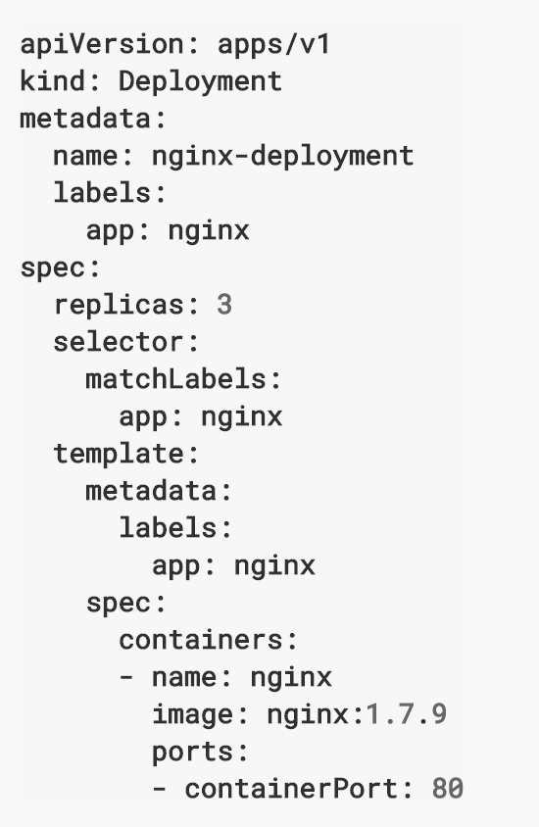
Deployment

Slide 62
Services
● Unified method of accessing the exposed workloads of Pods.
● Durable resource (unlike Pods)
static cluster-unique IP
static namespaced DNS name
<service name>.<namespace>.svc.cluster.local

Slide 63
Services
● Target Pods using equality based selectors.
● Uses kube-proxy to provide simple load-balancing.
● kube-proxy acts as a daemon that creates local entries in the host’s iptables for every service.

Slide 64
Services Types
There are 4 major service types:
ClusterIP (default)
NodePort
LoadBalancer
ExternalName

Slide 65
ClusterIP Services
ClusterIP services exposes a service on a strictly cluster internal virtual IP.
apiVersion: v1
kind: Service
metadata:
name: example-prod
spec:
selector:
app: nginx
env: prod
ports:
- protocol: TCP
port: 80
targetPort: 80

Slide 66
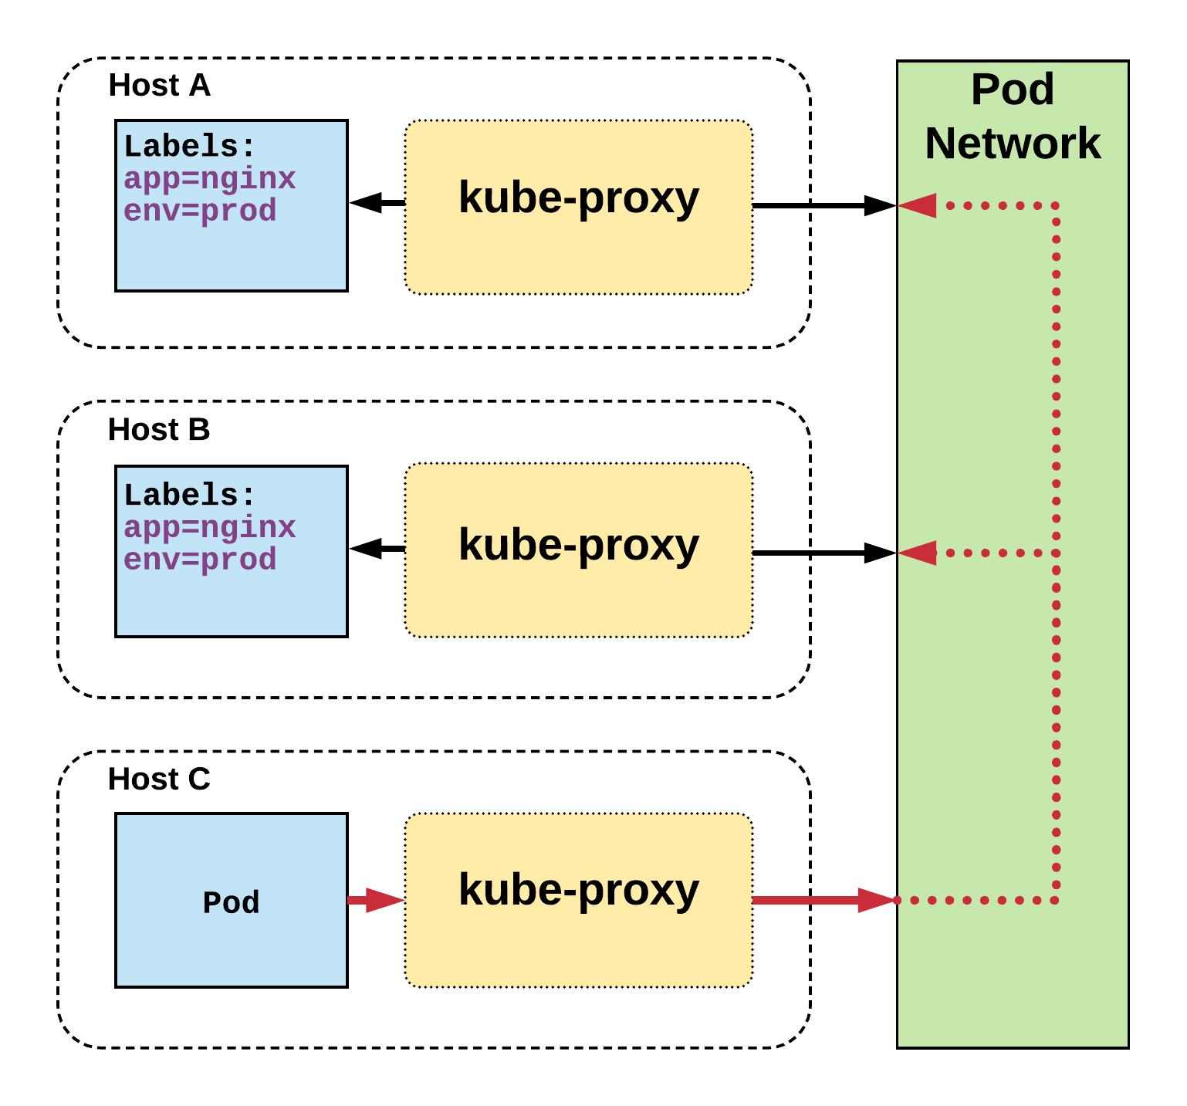
ClusterIP Services
Name: example-prod
Selector: app=nginx,env=prod
Type: ClusterIP
IP: 10.96.28.176
Port: <unset> 80/TCP
TargetPort: 80/TCP
Endpoints: 10.255.16.3:80, 10.255.16.4:80

Slide 67
NodePort Services
● NodePort services extend the ClusterIP service.
● Exposes a port on every node’s IP.
● Port can either be statically defined,or dynamically taken from a range between 30000-32767
apiVersion: v1
kind: Service
metadata:
name: example-prod
spec:
type: NodePort
selector:
app: nginx
env: prod
ports:
- nodePort: 32410
protocol: TCP
port: 80
targetPort: 80

Slide 68
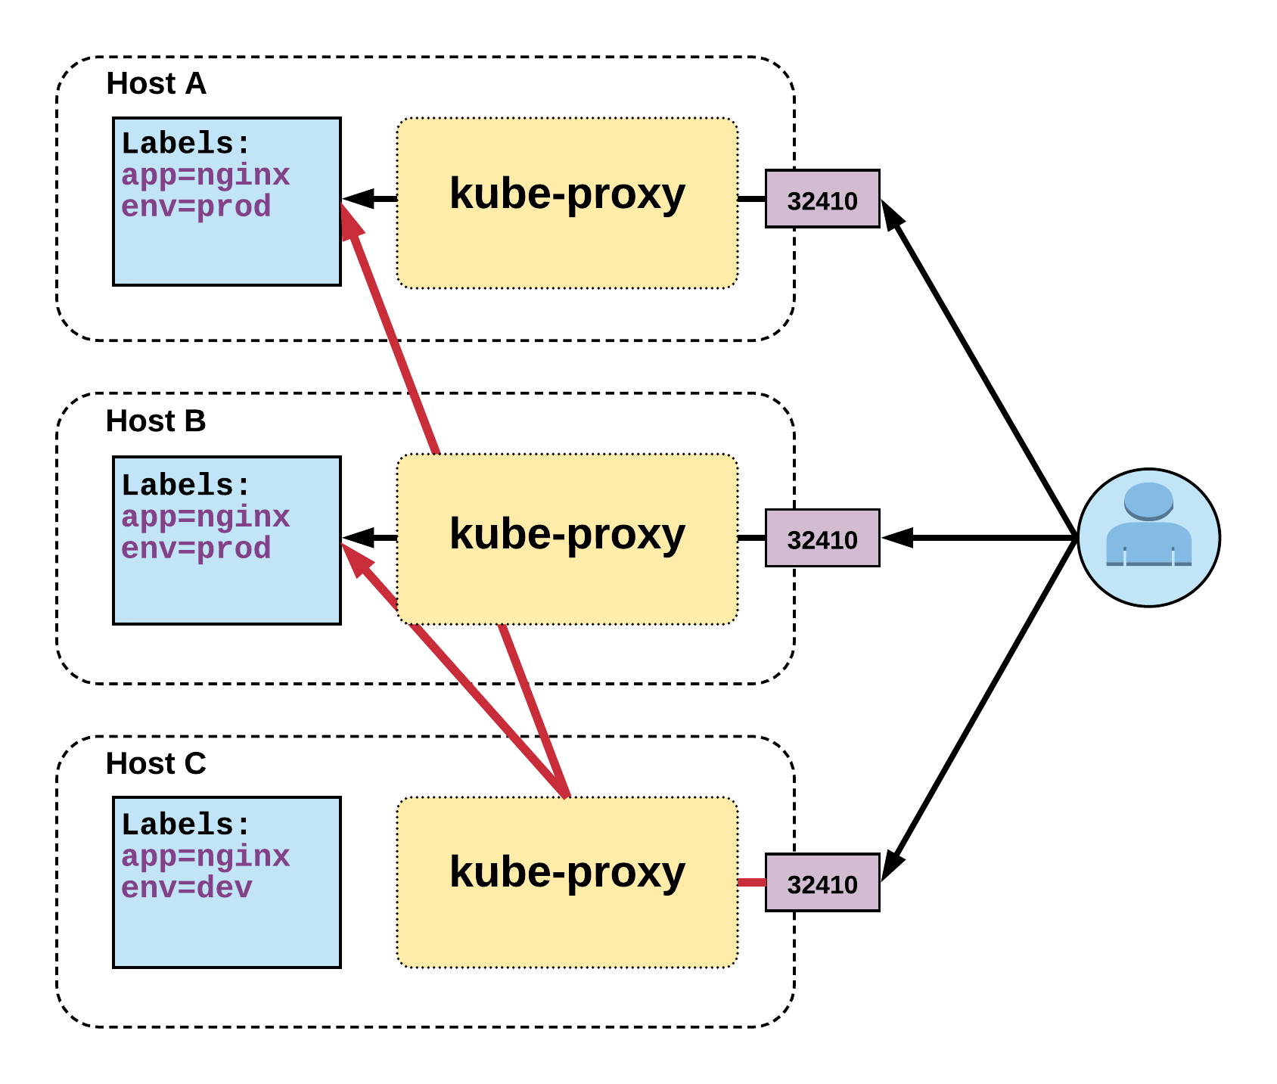
NodePort Services

Slide 69
LoadBalancer Services
apiVersion: v1
kind: Service
metadata:
name: example-prod
spec:
type: LoadBalancer
selector:
app: nginx
env: prod
ports:
protocol: TCP
port: 80
targetPort: 80

Slide 70
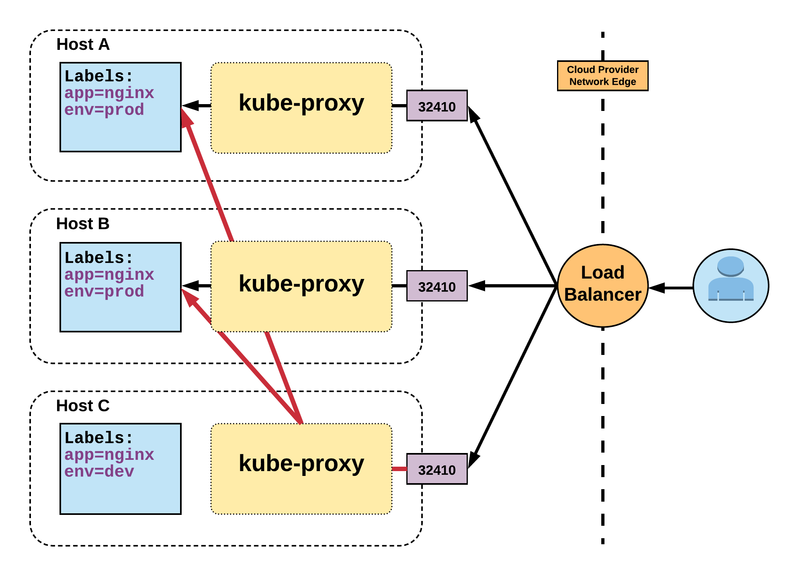
LoadBalancer Services

Slide 71
ExternalName Services
apiVersion: v1
kind: Service
metadata:
name: example-prod
spec:
type: ExternalName
spec:
externalName: example.com
● ExternalName is used to reference endpoints OUTSIDE the cluster.
● Creates an internal CNAME DNS entry that aliases another.

Slide 72
Ingress – Name Based Routing
apiVersion: extensions/v1beta1
kind: Ingress
metadata:
name: name-virtual-host-ingress
spec:
rules:
- host: first.bar.com
http:
paths:
- backend:
serviceName: service1
servicePort: 80
- host: second.foo.com
http:
paths:
- backend:
serviceName: service2
servicePort: 80
- http:
paths:
- backend:
serviceName: service3
servicePort: 80

Slide 73
Ingress – Path Based Routing
apiVersion: extensions/v1beta1
kind: Ingress
metadata:
name: simple-fanout-example
spec:
rules:
- host: foo.bar.com
http:
paths:
- path: /foo
backend:
serviceName: service1
servicePort: 4200
- path: /bar
backend:
serviceName: service2
servicePort: 8080

Slide 74
Lab 3: Deploying Spring Boot Application on K8s

Slide 75
Externalize Configuration in Kubernetes

Slide 76
Externalizing Application Configuration
● Kubernetes has an integrated pattern for decoupling configuration from
application or container.
● This pattern makes use of two Kubernetes components: ConfigMaps and
Secrets.

Slide 77
ConfigMap
● Provides a way to inject configuration data into a container .
● Externalized data stored within kubernetes.
● Can store entire files or provide key/value pairs
● Can be referenced through several different means:
environment variable
a command line argument (via env var)
injected as a file into a volume mount
● Can be created from a manifest, literals,
directories, or files directly.

Slide 78
Defining values in a ConfigMap manifest
apiVersion: v1
kind: ConfigMap
metadata:
name: manifest-example
data:
state: Michigan
city: Ann Arbor
content: |
Look at this,
its multiline!
data: Contains key-value pairs of ConfigMap contents.
# Create from a ConfigMap manifest
$ kubectl create -f file.configmap.yml

Slide 79
Defining key value pairs in a file
enemies=aliens
lives=3
enemies.cheat=true
enemies.cheat.level=high
apiVersion: v1
kind: ConfigMap
data :
game.config: |-
enemies=aliens
lives=3
enemies.cheat=true
enemies.cheat.level=noGoodRotten
Key/value pairs defined in a file called game.config
File name is used as the key for the values
Your application can now work with the content just as it would a normal configuration file(JSON/XML, keys/values could be used
# Create a ConfigMapusing data from a file
$ kubectl create configmap[cm-name] --from-file=[path-to-file]]

Slide 80
Creating ConfigMap
# Create a ConfigMap using data from a config file
$ kubectl create configmap [cm name] from file=[ path to file]
# Create ConfigMap from an env file
$ kubectl create configmap [cm name] from env file=[path to file]
# Create a ConfigMap from individual data values
$ kubectl create configmap [cm name] from literal= apiUrl =https://my api
--from literal= otherKey=otherValue
# Create from a ConfigMap manifest
$ kubectl create - f file.configmap.yml

Slide 81
Accessing ConfigMap : Environment vars
Pods can access ConfigMap values through environment vars
ENEMIES env variable created ( value=aliens)
apiVersion: v1
kind: ConfigMap
metadata:
name: app-settings
data:
enemies: aliens
lives: "3"
enemies.cheat: "true"
enemies.cheat.level=high
apiVersion: apps/v1
...
spec:
template:
...
spec:
containers: ...
env:
-name: ENEMIES
valueFrom:
configMapKeyRef:
key: app-settings
name: enemies
Environment variable name

Slide 82
Accessing ConfigMap : Environment vars
envFrom can be used to load all configMap keys/values into
environment variables
apiVersion: v1
kind: ConfigMap
metadata:
name: app-settings
data:
enemies: aliens
lives: "3"
enemies.cheat: "true"
enemies.cheat.level=high
apiVersion: apps/v1
...
spec:
template:
...
spec:
containers: ...
envFrom:
- configMapRef:
name: app-settings
Environment variable created for all data keys

Slide 83
Secret Core Concepts
● A secret is an object that contains a small amount of sensitive data such as password, a token, or a key.
● Functionally identical to a ConfigMap.
● Stored as base64 encoded content.
● Encrypted at rest within etcd (if configured!).
● Stored on each worker node in tmpfs directory.
● Ideal for username/passwords, certificates or other sensitive information that should not be stored in a container.
● Pods can access secrets to secure which users can create Pods. Role-Based access control (RBAC) can be used.

Slide 84
Creating a Secret
Secrets can be created using kubectl create secret
# Create a new secret named my-secret with keys for each file in folder bar
$ kubectl create secret generic my-secret --from-file=path/to/bar
# Create a new secret named my-secret with specified keys instead of names on disk
$ kubectl create secret generic my-secret --from-file=ssh-privatekey=~/.ssh/id_rsa --from-file=ssh- publickey=~/.ssh/id_rsa.pub
# Create a new secret named my-secret with key1=supersecret and key2=topsecret
$ kubectl create secret generic my-secret --from-literal=key1=supersecret --from- literal=key2=topsecret

Slide 85
Defining a secret in yaml
type: There are three different types of secrets within Kubernetes:
docker-registry - credentials used to authenticate to a container registry
generic/Opaque - literal values from different sources
tls - a certificate based secret
data: Contains key-value pairs of base64 encoded content.
apiVersion: v1
kind: Secret
metadata:
name: manifest-secret
type: Opaque
data:
username: ZXhhbXBsZQ==
password: bXlwYXNzd29yZA==

Slide 86
Using Secrets
# Get secrets
$ kubectl get secrets
# Get YAML for specific secret
$ kubectl get secrets db passwords -o yaml

Slide 87
Accessing a Secret: Environment vars
Pods can access Secret values through environment variables
apiVersion: v1
kind: Secret
metadata:
name: db-passwords
type: Opaque
data:
db-password: cGFzc3dvcmQ=
admin-password: dmVyeV9zZWNy=
apiVersion: apps/v1
...
spec:
template:
...
spec:
containers: ...
env:
- name: DATABASE_PASSWORD
valueFrom:
secretKeyRef:
name: db-passwords
key: db-password

Slide 88
Lab 4: Externalize App Configuration with ConfigMaps

